Slide 1

My Company Policy
Copilot Scenario Overview
© 2026 Microsoft Corporation All rights reserved.
Notes:
CELA disclaimer
Terms displayed or discussed are for explanation/education only. Such terms may differ from your agreement.

Slide 2
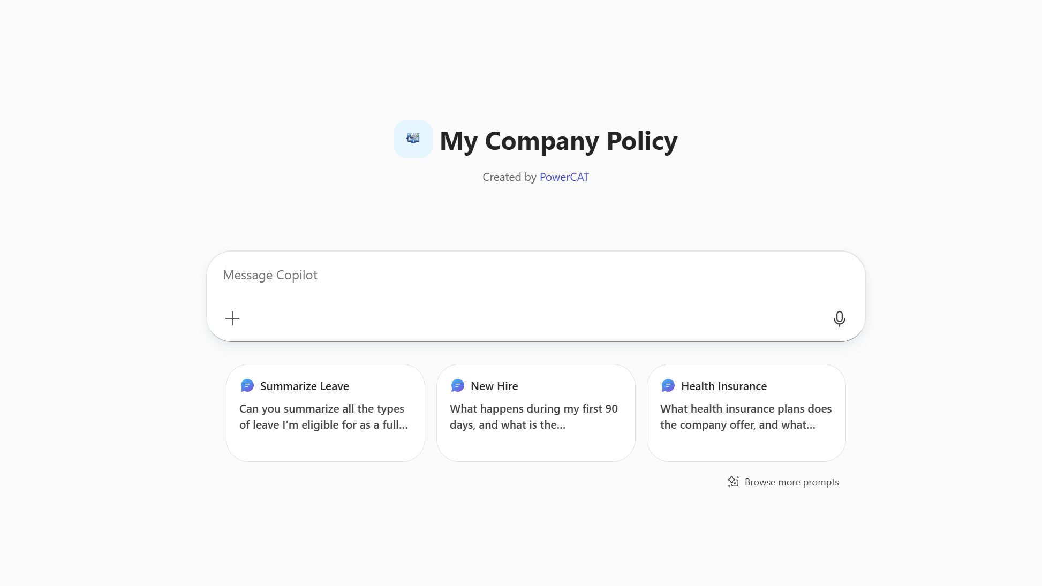
My Company Policy Agent Summary
Key Challenges
Agent Overview
Company knowledge is fragmented across intranets SharePoint sites, HR portals, and websites
Employees waste time searching for basic policy or benefits information
Critical policy information is missed or misunderstood
Business functions are overwhelmed with repetitive questions
Provide employees with a single, trusted conversational interface to access company policies, such as HR information, benefits, holidays, PTO, IT, procurement and general company information — without searching across multiple portals.
Business Outcomes
✅ Reduced ticket volume for support teams
⚡ Faster employee access to accurate information
📈 Improved benefits awareness and utilisation
🔒 Consistent, trusted answers across the organisation
Technical Features
💬 Conversational access via Microsoft 365 Copilot
📚 Grounding in authoritative internal documents and trusted web sources
📄 Policy, benefits, and service information retrieval
🔗 Direct links to official employee portals
Notes:
CELA disclaimer
Terms displayed or discussed are for explanation/education only. Such terms may differ from your agreement.

Slide 3
Overview
Persona Example
User Journey Scenario Example
Solution Screenshots
Demo Prompts
Table of Contents
Notes:
CELA disclaimer
Terms displayed or discussed are for explanation/education only. Such terms may differ from your agreement.

Slide 4
The My Company Policy Agent helps employees quickly find what company policies or HR information apply to them, what they need to know, and where to go next.
Instead of manually searching across intranet sites, HR/IT portals, and internal documentation, employees can ask the agent to explain policies, review benefits information, or provide guidance on topics like PTO, holidays, and workplace programs.
The agent grounds responses in authoritative internal documents and trusted company resources, returning clear, consistent answers that improve employee self‑service while reducing repetitive inquiries to HR teams.
Overview
© 2026 Microsoft Corporation All rights reserved.

Slide 5


Persona Example
From day-one new hires to long-tenured employees with a quick benefits question, the My Company Policy Agent is the trusted first stop that replaces portal-hopping.
New Hire
Existing Employee
Onboarding
Policy Inquiry
Recently joined the company
Needs fast answers on PTO, holidays, healthcare, and internal services
Uses the agent as a first stop instead of searching portals
Has a policy or benefits question
Asks the agent and gets an immediate, trusted answer with links to official portals
💬 Typical Ask
"What's covered under our dental plan?"
💬 Typical Ask
"How many PTO days do I have left?"
Key Challenges Addressed
Company knowledge fragmented across intranets, SharePoint sites, HR portals, and websites; employees waste time searching for basic policy or benefits information; HR teams overwhelmed with repetitive questions

Slide 6
User Journey
The agent grounds every answer in authoritative internal documents and trusted web sources, delivering clear responses with links and reducing HR escalation.
1
Trigger
2
Evaluation
3
Output
Employee asks Copilot a question about company policies or benefits, e.g., "What is our PTO policy?" or "How do I enrol in dental coverage?"
Agent evaluates the question, grounds the response in authoritative internal documents and trusted web sources, selects the most relevant, up-to-date information
Agent delivers a clear, concise answer with links to official portals or resources, reduces the need for follow-up questions or HR escalation
Backbone
Microsoft 365 Copilot
SharePoint & web grounding
Agent instructions & scope
Structured response

Slide 7


High Level Agent Architecture
My Company Policy Agent
Declarative agent
Trigger
Agent
Knowledge Sources
My Company Policy
Approved web sources and internal content
Instructions
User
Structured response returned to the user
User interacts via Microsoft 365 Copilot
Agent instructions define scope and trusted sources
Grounding via SharePoint / internal content + approved web sources
Structured response returned to the user

Slide 8
Agent Solution Screenshots
© 2026 Microsoft Corporation All rights reserved.
Notes:
Title: Click-through demo
Now, let’s see how that all comes together for our key persona.
CELA disclaimer
Terms displayed or discussed are for explanation/education only. Such terms may differ from your agreement.

Slide 9
Trigger
Notes:
CELA disclaimer Terms displayed or discussed are for explanation/education only. Such terms may differ from your agreement.

Slide 10
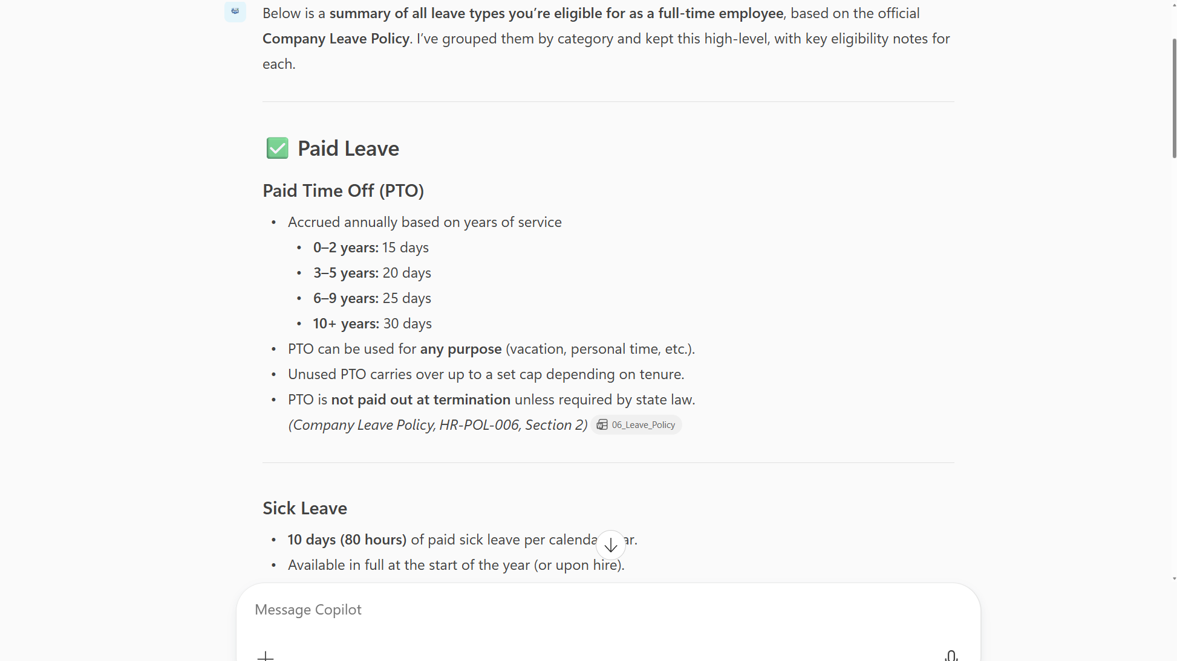
Output Example
Notes:
CELA disclaimer Terms displayed or discussed are for explanation/education only. Such terms may differ from your agreement.

Slide 11
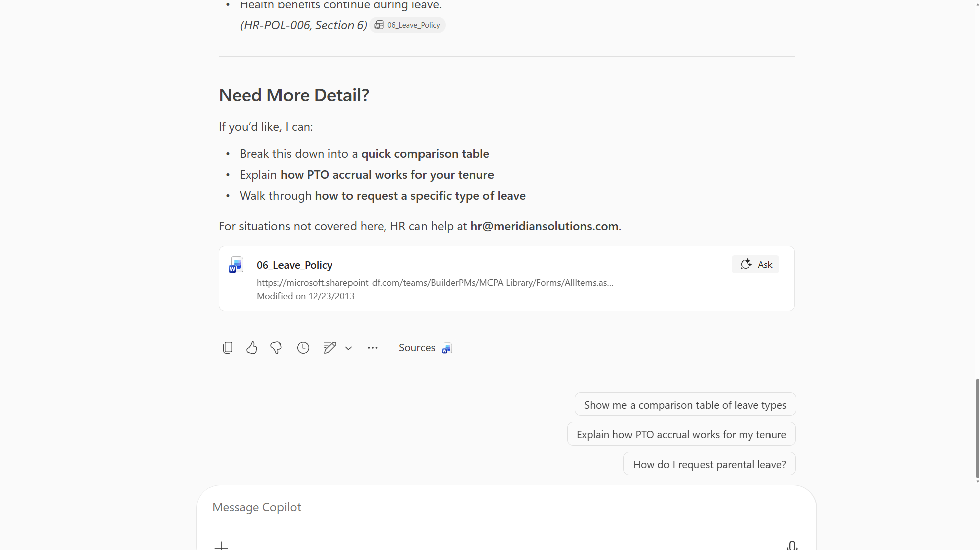
Output Example
Notes:
CELA disclaimer Terms displayed or discussed are for explanation/education only. Such terms may differ from your agreement.

Slide 12
Demo Prompts
© 2026 Microsoft Corporation All rights reserved.
Notes:
CELA disclaimer
Terms displayed or discussed are for explanation/education only. Such terms may differ from your agreement.

Slide 13
Demo Prompts
ID | Test Scenario | Prompt | Expected Result Description
1 | Remote Work Policy Retrieval | "What is the company's remote work policy?" | Verify it returns the remote work / hybrid work policy from HR documentation.
2 | Health Plan Comparison | "Explain the difference between the PPO and HDHP health plans" | Verify it compares healthcare plan options with coverage details, deductibles, and out-of-pocket maximums.
3 | Preventative Care Coverage | "What preventative care services are covered under my health plan?" | Verify it lists covered wellness visits, screenings, vaccinations, and mental health resources.
4 | Holiday Calendar Lookup | "How many holidays does the company observe this year?" | Verify it returns the full holiday calendar for the current year.
5 | PTO Accrual & Carryover Policy | "How does PTO accrual work and can I carry over unused days?" | Verify it explains PTO accrual rates, carryover limits, and any use-it-or-lose-it policies.
6 | IT Help Desk Navigation | "Where do I submit an IT help desk ticket?" | Verify it provides a direct link to the IT support portal and instructions for submitting a request.
7 | Executive Leadership Lookup | "Who is on the executive leadership team?" | Verify it returns leadership team information from the company website or intranet.
8 | Quarterly Earnings Summary | "What were the company's Q3 earnings results?" | Verify it surfaces the latest quarterly earnings summary from the public investor relations page.
9 | Region-Specific Policy (UK Maternity) | "What are the maternity leave policies for employees in the UK?" | Verify it returns UK-specific maternity leave policy details from localized HR documents.
10 | Town Hall Meeting Summary | "Summarize the latest company town hall meeting" | Verify agent provides concise summary of key topics and announcements.
11 | Facilities Contact & Process | "Who do I contact for a facilities or building maintenance request?" | Verify it returns facilities contact info and/or request process for maintenance requests.
12 | Mental Health & Wellness Resources | "What mental health resources are available to me?" | Verify agent provides EAP details, mental health counseling benefits and wellness programs. If varies across regions, provides links to all.
13 | Multi-Source Reasoning (PTO + Holidays) | "How much PTO will I need to use if I take off the last 2 weeks of December?" | Agent combines holiday calendar data (SharePoint) with PTO policy to calculate working days needing PTO.

Slide 14
Thank You
Notes:
CELA disclaimer
Terms displayed or discussed are for explanation/education only. Such terms may differ from your agreement.

